Slide 1
ICJ Rule Amendment, Forms, and UNITY Training
Session B:
Returns & Failed Supervision
Rules Effective April 1, 2024

Slide 2
Training Agenda
Review ICJ Rule Changes
Review Form Changes
Demonstrate UNITY Changes
Q & A

Slide 3
Which ICJ Rules are Changing?
Session B
7-106: Transportation
7-107: Airport Supervision
5-103: Reporting Juvenile Non-Compliance and Retaking
NEW 5-103A: Failed Supervision Determined by Receiving State

Slide 4
Returns: Transportation
Rule 7-106(3) & (4) gives states more discretion regarding items a juvenile can travel with during returns and allows confiscated items to be returned via checked luggage.

Slide 5
Rule 7-106(3)&(4) Amendments
3. In collaboration with the holding/receiving state, demanding/sending state, and the intermediate airport state, discretion shall be used when determining which personal items may accompany the juvenile on their return. Holding/receiving states shall not return to juveniles any personal belongings which could Items that may jeopardize the health, safety, or security of the juveniles or others shall be confiscated.(examples: weapon, cigarettes, medication, lighters, change of clothes, or cell phone).
4. Holding/receiving states shall confiscate all questionable Confiscated personal belongings and return those belongings shall be returned to the legal guardians by checked luggage, approved carrier, COD, or at the expense of the home/demanding/sending state (e.g., United States Postal Service, United Parcel Service, or Federal Express).

Slide 6
Rule 7-106(8) Amendment
8. In the event of an emergency situation including but not limited to weather, accident, mechanical issue, delayed flight, or missed flight, that interrupts or changes established travel plans during a return transport, the ICJ member states may provide necessary services and assistance, including temporary detention or appropriate shelter arrangements for the juvenile until the transport is rearranged and/or completed.

Slide 7
Returns: Airport Supervision
Rule 7-107(3) revised to state that home/demanding states are required to request, rather than merely notify, layover states of airport supervision needs no later than 48-hours prior to the event.
Surveillance states have the discretion to make exceptions to the 48-hour rule.

Slide 8
Rule 7-107(3) Amendments
3. Home/demanding/sending states shall request give the states providing airport supervision a minimum of forty-eight (48) hours in advance notice. Exceptions may be approved by the intermediate airport state.

Slide 9
Failed Supervision
Previous failed supervision language from 5-103 edited and relocated to new 5-103A.
New Rule 5-103A clarifies criteria for determining that supervision has failed, eligibility for retaking, and requirements for both states, including use of new Form IX: Failed Supervision Report.
Form
Impacts
UNITY Impacts

Slide 10
Rule 5-103 Amendment
Reporting Juvenile Non-Compliance, Failed Supervision and Retaking
4. Upon request from the receiving state, the sending state’s ICJ Office shall return the juvenile within five (5) business days in accordance with these rules when:
a. A legal guardian remains in the sending state and the supervision in the receiving state fails as evidenced by:
i. When a juvenile is no longer residing in the residence approved by the receiving state due to documented instances of violation of conditions of supervision; or
ii. When an alternative residence is determined to be in the best interest of the juvenile due to documented instances of violation of conditions of supervision and no viable alternatives exist in the receiving state; or
iii. When an immediate, serious threat to the health and safety of the juvenile and/or others in the residence or community is identified; and
iv. The receiving state has documented efforts or interventions to redirect the behavior.
b. The juvenile is not residing with a legal guardian and that person requests the juvenile be removed from his/her home. The sending state shall secure alternative living arrangements within five (5) business days or the juvenile shall be returned. This time period may be extended up to an additional five (5) business days with the approval from both ICJ Offices.
c. A juvenile student or juvenile who resides independently in the receiving state whose transfer of supervision fails.

Slide 11
NEW Rule 5-103A(1)
RULE 5-103A: Failed Supervision Determined by Receiving State
1. The receiving state may determine supervision has failed when a juvenile is not detained and one of the following circumstances applies:
a. A legal guardian remains in the sending state, the receiving state has documented efforts
or interventions to redirect the behavior, and:
i. The juvenile no longer resides in the residence approved by the receiving state due to
documented instances of violation of conditions of supervision; or
ii. An alternative residence is determined to be in the best interest of the juvenile due to
documented instances of violation of conditions of supervision and no viable alternatives
have been located in the receiving state; or
iii. An immediate, serious threat to the health and safety of the juvenile and/or others in the
residence or community is identified.
b. The juvenile does not reside with a legal guardian and the person with whom the juvenile
resides requests the juvenile be removed from his/her home.
c. The juvenile is a student or resides independently in the receiving state and the transfer of
supervision fails due to documented instances of violations of conditions of supervision, and
the receiving state has documented efforts or interventions to redirect the behavior.

Slide 12
NEW Rule 5-103A(2)
2. Upon a determination of failed supervision, the receiving state shall notify the sending state using Form IX, Failed Supervision Report, which shall contain the following information:
a. Details regarding how the supervising agent determined
supervision in the receiving state failed; and
b. Description of efforts or interventions to redirect behavior or
maintain current residence; and
c. Any pending charges in the receiving state.

Slide 13
NEW Rule 5-103A(3)
3. The sending state shall respond to the Form IX, Failed Supervision Report, no later than ten (10) business days following receipt by the sending state.
a. The response shall provide details of an alternative living
arrangement secured by the sending state or provide notice that a
decision has been made to return the juvenile.
b. If an alternative living arrangement is not secured, the juvenile shall
be returned no later than ten (10) business days following receipt of
the Form IX, Failed Supervision Report, by the sending state. This time
period may be extended up to an additional five (5) business days
with the approval from both ICJ Offices.

Slide 14
Form IX
UNITY
Form IX
UNITY
NEW Form IX: Failed Supervision Report contains all required information for a receiving state to submit a failed supervision report to the sending according to Rule 5-103A.
The new form also contains required response fields for the sending state to indicate the plan of action to return the juvenile or secure an alternative residence.
Form IX – Failed Supervision Report requires the Sending State to either “Return Juvenile” or “Secure Alternative Address” with 10 business day

Slide 15
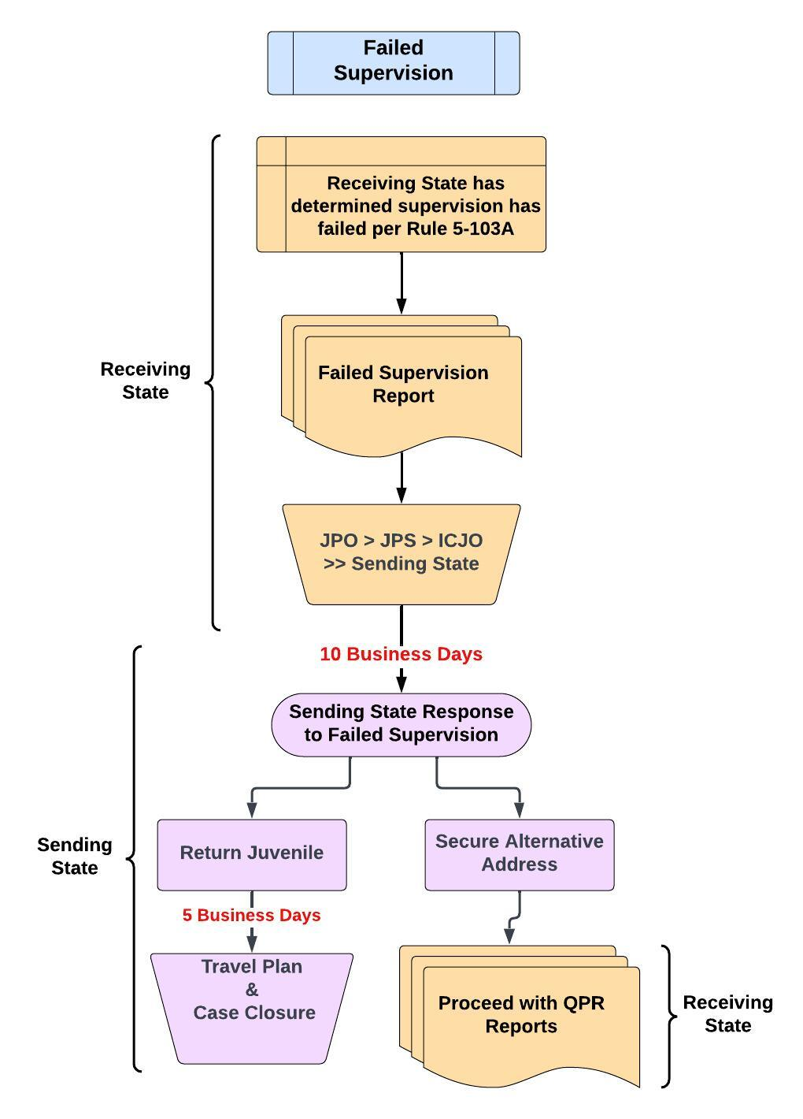

Slide 16
Checkpoint
True or False?
All states are required to provide temporary detention or shelter in the event of an emergency situation (e.g., weather, accident, missed flight) that affects the travel arrangements for a juvenile who is being returned pursuant to the ICJ.

Slide 17
Checkpoint
False
All states are required to provide temporary detention or shelter in the event of an emergency situation (e.g., weather, accident, missed flight) that affects the travel arrangements for a juvenile who is being returned pursuant to the ICJ.

Slide 18
Checkpoint
Which of the following statements is TRUE regarding a failed supervision?
A. A student living independently in the receiving state can have a failed
supervision without any prior documented instances of violations.
B. When a juvenile is living with someone other than their legal guardian
and that person no longer wants the juvenile to reside in their home,
the receiving state can determine the supervision has failed.
C. A juvenile who is detained in the receiving state is eligible to be
returned due to failed supervision.

Slide 19
Checkpoint
Which of the following statements is TRUE regarding a failed supervision?
A. A student living independently in the receiving state can have a failed
supervision without any prior documented instances of violations.
B. When a juvenile is living with someone other than their legal guardian
and that person no longer wants the juvenile to reside in their home,
the receiving state can determine the supervision has failed.
C. A juvenile who is detained in the receiving state is eligible to be
returned due to failed supervision.

Slide 20
Training Materials & Infographic Available on Commission’s website:
https://juvenilecompact.org/
training/training-materials
Q & A
Rules Effective April 1, 2024

