Slide 1
ICJ Rule Amendment, Forms, and UNITY Training
Session A:
Transfers of Supervision & Travel Permits
Rules Effective April 1, 2024

Slide 2
Training Agenda
Review ICJ Rule Changes
Review Form Changes
Demonstrate UNITY Changes
Q & A

Slide 3
Which ICJ Rules are Changing?
Session A
1-101: Relocate
4-101: Eligibility Requirements for the Transfer of Supervision
4-103: Transfer of Supervision Procedures for Juvenile Sex Offenders
8-101: Travel Permits
4-104: Authority to Accept/Deny - Form/UNITY Change

Slide 4
Relocation & Eligibility
Rules 4-101(2)and 4-103(3) were revised to clarify that the juvenile doesn’t have to move to the receiving state but may already reside there.
Transfers are required whenever juveniles reside in a state other than where supervision was ordered.
The definition of “relocate” is removed from Rule 1-101. The standard dictionary version applies rather than previous ICJ definition requiring a 90-consecutive day time-period.

Slide 5
Rule 4-101(2)Amendments
2. No state shall permit a juvenile who is eligible for transfer under this Compact to reside in relocate to another state except as provided by the Compact and these rules. A juvenile shall be eligible for transfer under ICJ if the following conditions are met:
a. is classified as a juvenile in the sending state; and
b. is an adjudicated delinquent, adjudicated status offender, or has
a deferred adjudication in the sending state; and
c. is under the jurisdiction of a court or appropriate authority in the
sending state; and
d. has a plan inclusive of residing in relocating to another state for
a period exceeding ninety (90) consecutive days in any twelve
(12) month period; and

Slide 6
Rule 4-103(3) Amendments
3. When it is necessary for a juvenile sex offender to relocate or reside with a legal guardian prior to the acceptance of supervision, and there is no legal guardian in the sending state, the sending state shall determine if the circumstances of the juvenile’s immediate relocation justify the use of a Form VII Out-of-State Travel Permit and Agreement to Return, including consideration of the appropriateness of the residence. If approved by the sending state’s ICJ Office, the following shall be initiated:

Slide 7
Reporting Instructions
Rule 4-104(6) clarifies Form V, Notification of Sending State Upon Parolee or Probationer Proceeding to the Receiving State, must be used to notify receiving state of juvenile’s departure

Slide 8
Rule 4-104(6) Amendment
6. Upon receipt of acceptance of supervision from the receiving state, and prior to the juvenile's departure if the youth is not already residing in the receiving state, the sending state shall provide reporting instructions to the juvenile, and provide a Form V, Notification from Sending State of Parolee or Probationer Proceeding to the Receiving State, written notification of the juvenile's departure to the receiving state.

Slide 9
Travel Permits
Rule 8-101 (1) revised to clarify travel permits are required for a wide variety of cases, including
juveniles supervised for specified offenses, regardless of whether they are adjudicated or have deferred adjudications
all juveniles pending a transfer, even those returning to the state in which they typically reside

Slide 10
Rule 8-101(1) Amendments
1. All travel permits shall be submitted prior to the juvenile’s travel. Travel permits shall be mandatory for the following juveniles traveling out-of-state for a period in excess of twenty-four (24) consecutive hours who meet the criteria set forth in 1(a) or 1(b):
a. Juveniles who have been adjudicated or have deferred adjudications and
are on supervision for one of the following:
i. sex-related offenses;
ii. violent offenses that have resulted in personal injury or death; or
iii. offenses committed with a weapon;
b. Juveniles who are one of the following:
i. state committed;
ii. relocating pending a request for transfer of supervision, and who are
subject to the terms of the Compact;
iii. returning to the state from which they were transferred for the purposes of
visitation;
iv. transferring to a subsequent state(s) with the approval of the original
sending state; or
v. transferred and the victim notification laws, policies and practices of the
sending and/or receiving state require notification.

Slide 11
Acceptance of Supervision Cases
Rule 4-104(4) revised to clarify that transfer requests must be accepted in most cases.
If the transfer is not recommended, a detailed justification must be provided.
Form
Impacts
UNITY Impacts

Slide 12
Rule 4-104(4)&(5) Amendments
4. Supervision shall be accepted unless may be denied when the home evaluation reveals that the proposed residence is unsuitable or that the juvenile is not in substantial compliance with the terms and conditions of supervision required by the sending or receiving state. Supervision shall also be accepted as provided in Rule 4-104(5). When supervision is not recommended, the Form VIII, Home Evaluation Report, shall include a detailed justification to include why the proposed residence is not safe and/or suitable. , except when a juvenile has no legal guardian remaining in the sending state and the juvenile does have a legal guardian residing in the receiving state.
5. Supervision shall be accepted when a juvenile has no legal guardian remaining in the sending state and the juvenile does have a legal guardian residing in the receiving state.
PENDING CHALLENGES TO RULE CHANGES

Slide 13
Form VIII
UNITY
Form VIII
UNITY
The Form VIII: Home Evaluation Report will contain a new field titled “Detailed Justification” on Page 3 which is required if supervision is not recommended.
Recommendation check boxes moved to Page 3.
Language edited to indicate that Reporting Instructions are required if youth is not already residing the receiving state.
“Not Recommended” Home Evaluation triggers the required data field:
DETAILED JUSTIFICATION IF SUPERVISION NOT RECOMMENDED
(include why proposed residence is not safe and/or suitable)
Notes:
SCREEN SHARE FOR FORM AND UNITY DEMO.
Form outside of UNITY
Form and process inside of UNITY

Slide 14
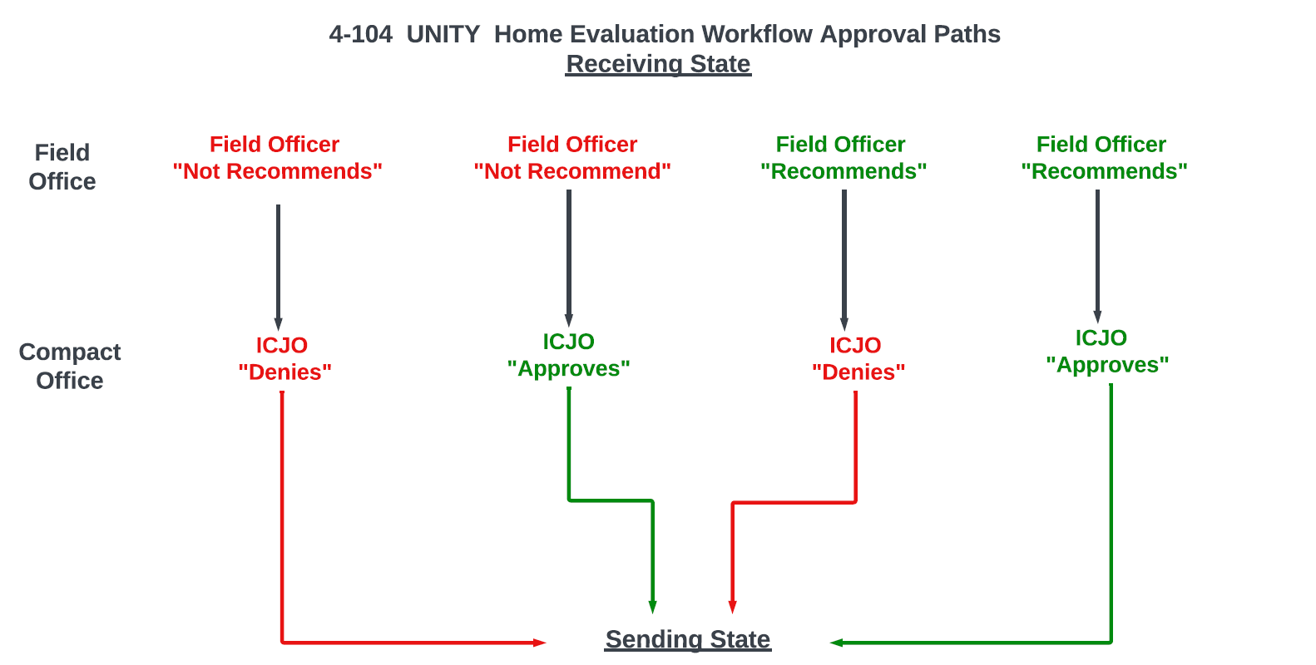

Slide 15
Checkpoint
Which of the following scenario(s) requires a travel permit?
A. Juvenile is adjudicated out-of-state, is on supervision, and already
resides in the receiving state
B. Juvenile parolee must relocate with parents to the receiving state
prior to acceptance of supervision
C. Juvenile has a deferred adjudication for a sex offense, is on
supervision, and is going on vacation for a week in another state
D. All of the above
E. Only b & c

Slide 16
Checkpoint
Which of the following scenario(s) requires a travel permit?
A. Juvenile is adjudicated out-of-state, is on supervision, and already
resides in the receiving state
B. Juvenile parolee must relocate with parents to the receiving state
prior to acceptance of supervision
C. Juvenile has a deferred adjudication for a sex offense, is on
supervision, and is going on vacation for a week in another state
D. All of the above
E. Only b & c

Slide 17
Checkpoint
If a local probation officer does NOT recommend supervision on the home evaluation, which of the following are true, if any?
A. The receiving state Compact Office must deny supervision
B. The receiving state Compact Office can override the
recommendation and approve supervision
C. The probation officer must include a detailed description as to why
supervision is not recommended

Slide 18
Checkpoint
If a local probation officer does NOT recommend supervision on the home evaluation, which of the following are true, if any?
A. The receiving state Compact Office must deny supervision
B. The receiving state Compact Office can override the
recommendation and approve supervision
C. The probation officer must include a detailed description as to why
supervision is not recommended

Slide 19
Training Materials & Infographic Available on Commission’s website:
https://juvenilecompact.org/
training/training-materials
Q & A
Rules Effective April 1, 2024

