Slide 1





Interstate Commission for Juveniles
Home Evaluation Considerations for Unconventional Families
View the Best Practice at
juvenilecompact.org
Notes:
Hello, and welcome to our ICJ Wednesday Workshop on Home Evaluation Considerations for Unconventional Families!
Today's training will be presented by members of the Racial Diversity, Equity, and Inclusion Committee.

Slide 2


About the Best Practice
In 2023, the RDEI Committee developed a Best Practice resource to emphasize the importance of applying the spirit of the Compact to home evaluations of youth who reside with caregivers not identified as parents/legal guardians. It demonstrates a commitment to addressing racial DEI and acknowledges that bold, strategic action must be taken in areas where disparity exists.
RDEI Committee
Formed in 2022, the Racial DEI Committee develops strategies to promote awareness of diversity and foster greater equity and inclusion.
Notes:
About the Best Practice
-In 2023, the RDEI Committee developed a Best Practice titled "Home Evaluation Considerations for Unconventional Families" to emphasize the importance of applying the spirit of the Compact to home evaluations of youth who reside with caregivers not identified as parents/legal guardians.
RDEI Committee
-Formed in 2022, the Racial Diversity, Equity, and Inclusion Committee develops strategies to promote awareness of diversity and foster greater equity and inclusion.
-The Committee reviews the Commission’s data, Rules, policies, operations, and resources, and makes specific recommendations to promote
equity and procedural justice.

Slide 3
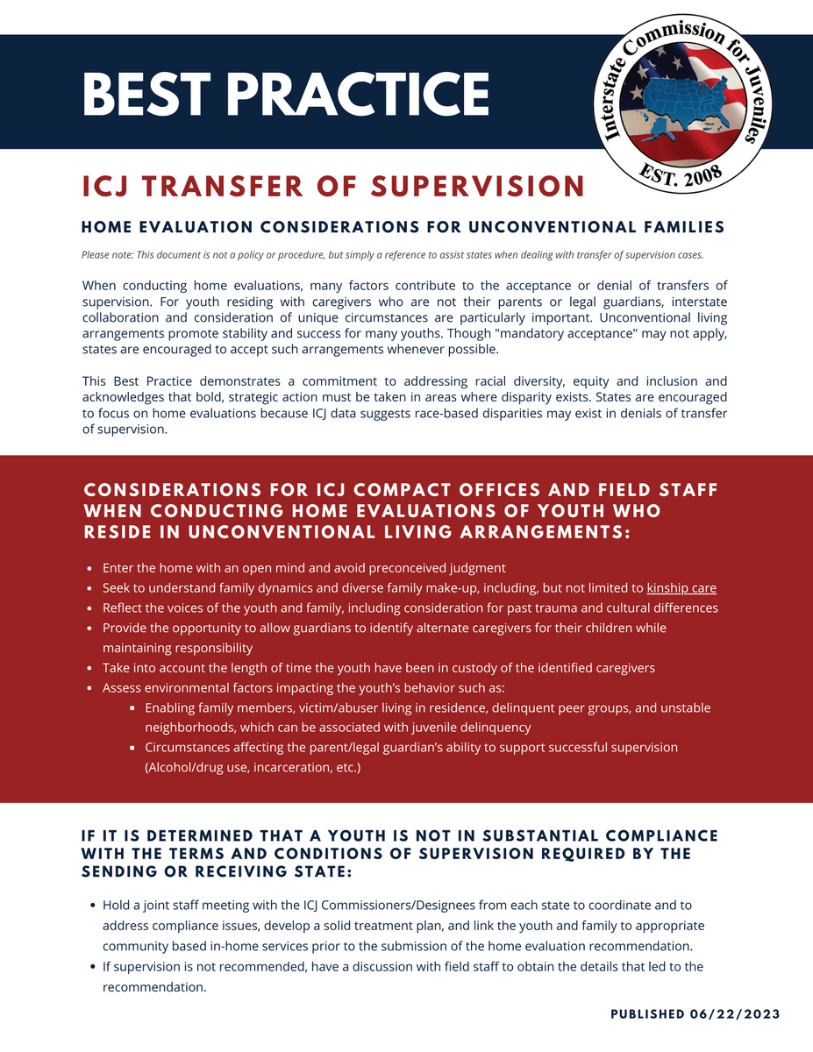
Notes:
The Best Practice demonstrates a commitment to addressing racial DEI and acknowledges that bold, strategic action must be taken in areas where disparity exists.
It includes considerations for ICJ Compact Office and Field Staff when conducting home evaluations of youth who reside in unconventional living arrangements and includes steps to take if it is determined that a youth is not in substantial compliance with the terms and conditions of supervision required by the sending or receiving state.
Let people know where it's located on the website.

Slide 4


What’s New?
Home Evaluations
ICJ Rule 4-104
Home evaluations are mandatory tasks used to assist in the decision-making process for the transfer of supervision of juveniles. This task shall be completed using the ICJ Form VIII: Home Evaluation Report.
In 2023, RDEI Committee Chair S. Jones (MD) and Vice Chair F. Casey (DE) proposed a rule amendment on behalf of the committee. The rule amendment was adopted at the 2023 Annual Business Meeting and went into effect on April 1, 2024.
Notes:
Home evaluations are mandatory tasks used to assist in the decision-making process for the transfer of supervision of juveniles. This task shall be completed using the ICJ Form VIII: Home Evaluation Report.
ICJ Rule 4-104 Amendment
In 2023, Racial Diversity, Equity, and Inclusion Committee Chair S. Jones (MD) and Vice Chair F. Casey (DE) proposed a rule amendment on behalf of the committee.
The rule amendment was adopted at the 2023 Annual Business Meeting and went into effect on April 1, 2024.

Slide 5

What should you consider when conducting a home evaluation?
  Enter the home with an open mind and avoid preconceived judgment
  Seek to understand family dynamics and diverse family make-up, including, but not limited to kinship care
  Reflect the voices of the youth and family, including consideration for past trauma and cultural differences
  Provide the opportunity to allow guardians to identify alternate caregivers for their children while maintaining responsibility
Notes:
When conducting home evaluations you should:
-Enter the home with an open mind and avoid preconceived judgment
-Seek to understand family dynamics and diverse family make-up, including, but not limited to kinship care
-Reflect the voices of the youth and family, including consideration for past trauma and cultural differences
-Provide the opportunity to allow guardians to identify alternate caregivers for their children while maintaining responsibility

Slide 6






Cross-Cultural Attitude Strategies
01
Practice Openness
Demonstrate acceptance of difference and ambiguity
02
Demonstrate Humility
Suspend judgement and have the ability to learn
03
Demonstrate Sensitivity
Appreciate cultural differences
Notes:
Developing cultural competence helps us understand, communicate with, and effectively interact with people across cultures.
It gives us the ability to compare different cultures with our own and better understand the differences.
Unconsciously, we bring our own cultural frame of interpretation to any situation. This is not to say that culture alone determines how one interprets a situation.
Developing cross-cultural attitudes allows one to develop skills for better engaging with people from all kinds of cultures.
Cross-cultural attitude strategies that can help you to develop and enhance one's ability to practice effective communication in intercultural situations include:
-Practicing openness by demonstrating acceptance of difference and ambiguity.
-Demonstrating humility through suspension of judgment and the ability to learn.
-Being sensitive to others by appreciating cultural differences.
Cultural competence is a non-linear, dynamic process that is never-ending and ever expending. It is built on increases in knowledge and skill development related to its attributes.

Slide 7



Unconventional Family Compositions
Length of time in custody
Services already in place
Accepting this living situation may provide continuity and stability for the youth and family.
Family work may be in progress with both the biological family and the identified caretaker.
Consistent living situation
“Family” looks different for everyone
The current living situation with this caretaker may be the most consistent and appropriate living situation the youth has.
This caretaker may be the most familiar “family” the youth has known.
Notes:
Consider allowing parents to identify an alternate caregivers for their children while maintaining responsibility, empowering families to make decisions for their children.
Consider the length of time the youth has been in custody of the identified caretaker.
• A youth may have someone that has been identified as their caretaker prior to the request for a transfer to another state. This person may have been caring for this youth for a significant period of time. Accepting this living situation provides continuity and stability for the youth and family.
• Services may already be in place and have begun. Family work may be in progress with both the biological family and the identified caretaker.
• The current living situation with this caretaker may be the most consistent and appropriate living situation the youth has been in.
• This caretaker may be the most familiar “family” the youth has known.

Slide 8





Items to Consider when Reviewing a Home Evaluation:
Socio-Economic Factors
Were Tools Utilized?
Past Trauma and Cultural Differences
Family Dynamics
Reflect the voices of the youth & family
Are socio-economic factors, such as economic disadvantages and unstable communities, key factors in the determination? Is the family aware of community supports?
If tools are utilized during the home evaluation process, are they evidence-based, transparent, and varied?
Has consideration for past trauma, or cultural differences, been given to account for the behavior and communication style of the youth and family during the home evaluation process?
Is there an understanding of family dynamics? Are the conditions of probation achievable or are there factors outside the control of the youth and family that are difficult to overcome?
Has the process been explained to the youth and family in terms they can best understand? Are there any language barriers? Can a translator be provided?
Notes:
*Different isn't always bad. Our own biases or misperceptions should not get in the way of a fair evaluation.*
The concept of cultural humility refers, in part, to one’s understanding, and self-awareness related to unconscious bias and its impact on decision-making, and in the context of the home evaluation process the intention to respect and honor the beliefs, values and customs of the family and youth in a multi-cultural context. Items to consider when reviewing a home evaluation should include:
• Are socio-economic factors, such as economic disadvantages and unstable communities, key factors in the determination? Is the family aware of community supports?
• If tools are utilized during the home evaluation process, are they evidence-based, transparent, and varied?
• Has consideration for past trauma, or cultural differences, been given to account for the behavior and communication style of the youth and family during the home evaluation process?
• Is there an understanding of family dynamics and flexibility given to meet youth and family where they are? Are the conditions of probation achievable or are there factors outside the control of the youth and family that are difficult to overcome?
• Has the process been explained to the youth and family in terms they can best understand? Are there any language barriers? Can a translator be provided?

Slide 9


Environmental Factors
Helping to eliminate or reduce such factors can produce favorable outcomes for youth.
Enabling family or peer groups
Enabling family members, delinquent peer groups, and unstable neighborhoods can be associated to juvenile delinquency.
Parent/Legal Guardian Capabilities
Incarceration, alcohol/drug addiction, refusal to provide care. Foster care/residential care should be the last option.
Abuse and/or Victim Living in Home
The youth should not remain in a living situation that is unsafe and not in the best interest and wellbeing of the youth and/or victim.
Unstable Living Situations
Homelessness of the parent/legal guardian may cause for a temporary disruption and relocation of a youth.
Notes:
Consider environmental factors impacting the youth’s behavior.
Helping to eliminate or reduce such factors can produce favorable outcomes for youth.
Enabling family members, delinquent peer groups, and unstable neighborhoods can be associated to juvenile delinquency.
Parent/legal guardian Capabilities (Alcohol/drug use, incarceration, etc.)
• The parent/legal guardian remaining in the sending state is currently incarcerated and will be for a significant period of time.
•The parent/legal guardian remaining in the sending state is currently in active addiction causing the situation to within their home to be unsafe and unpredictable.
•The parent/legal guardian is refusing to provide care and support for their child. They are not willing to allow the child to remain in their home. An alternative living situation is necessary. This should be at the lowest level of care and cause the least amount of disruption in the youth’s life. Foster care/residential care should be the last option and only utilized if there is no other caretaker available or willing to provide care for the youth.
Abuse
• There is a caretaker in the home who has been physically, verbally, emotionally, and/or sexually abusive to the youth. Remaining in that living situation is unsafe and not in the best interest and wellbeing of the youth.
• There is another person living within the home who is the victim of the youth’s offense. Living with the victim is not an option and the victim relocating is not an option.
Living Situations
• Homelessness of the parent/legal guardian may cause for a temporary disruption and relocation of a youth in order for the parent/legal guardian to get things in place to resume care for their child.
These factors should be included in the new "detailed justification if supervision not recommended (include why proposed residence is not safe and/or suitable)" field on the Form VIII form.

Slide 10

Substantial Compliance
ICJ Rule 1-101 defines substantial compliance as sufficient compliance by a juvenile with the terms and conditions of his or her supervision so as not to result in initiation of revocation of supervision proceedings by the sending or receiving state.
A determination that a youth is not in substantial compliance with the terms and conditions of supervision required by the sending or receiving state can be ascertained through highly subjective means.
Notes:
ICJ Rule 1-101 defines substantial compliance as sufficient compliance by a juvenile with the terms and conditions of his or her supervision so as not to result in initiation of revocation of supervision proceedings by the sending or receiving state.

Slide 11

Supportive Documentation
Provide a Detailed Explanation
A detailed, well-rounded explanation of the behavior warranting the determination which includes both aggravating and mitigating factors.
Account of the Level of Supervision
An account of the sending state’s level of supervision and efforts to address non-compliance while the home evaluation is in progress.
Hold a Joint Staff Meeting
Hold a joint staff meeting with the ICJ Commissioners/Designees from each state to coordinate and to address compliance issues.
Discuss the Recommendation
If supervision is not recommended, have a discussion with field staff to obtain the details that led to the recommendation.
Notes:
A determination that a youth is not in substantial compliance with the terms and conditions of supervision required by the sending or receiving state can be ascertained through highly subjective means and therefore should be supported by the following:
• A detailed, well-rounded explanation of the behavior warranting the determination which includes both aggravating and mitigating factors.
• An account of the sending state’s level of supervision and efforts to address non-compliance while the home evaluation is in progress.
-Did the sending state maintain contact with the youth and family during this period?
-Were the conditions adequately explained to the youth?
-Were interventions or graduated sanctions enacted to effect behavior change?
-Has all pertinent information about the youth been shared with the proposed caregiver to the degree that the caregiver understands both the youth’s history and needs, and the conditions of probation/parole?
• Did the ICJ Commissioners/Designees from each state coordinate and hold a joint staff meeting to address compliance issues, develop a solid treatment plan and link the youth and family to appropriate community based in-home services prior to the submission of the home evaluation recommendation?
• If supervision is not recommended, have a discussion with field staff to obtain the details that led to the recommendation.

Slide 12

Additional Resources
For more information on conducting home evaluations, access the following resources:
Home Evaluation
Best Practice
Located on the Commission’s website under the Resources and Best Practices tab.
LMS Courses on ICJ.TalentLMS
ICJ-100: Conducting Home Evaluations
WW-100: Home Evaluations
Notes:
For additional information on conducting home evaluations, access the following resources:
Home Evaluation Considerations for Unconditional Families
-Located on the Commission's website under the Resources and Best Practices tab.
Home Evaluation LMS Courses
-Located on the Commission's learning management system, ICJ.TalentLMS
-ICJ-100: Conducting Home Evaluations
This course provides an overview of the Commission's process for conducting home evaluations.
-WW-100: Home Evaluations
This course is a recording of the first session of the ICJ Wednesday Workshop live training series on Home Evaluations. The PowerPoint Presentation, handout, and form example can be downloaded for in-state trainings from the "Files" section of this course (below) or from the "Training Materials" page on the Commission's website.

Slide 13

Interstate Commission for Juveniles
Q&A Session
Please unmute yourselves or type questions in the chat!
For additional information, visit:
juvenilecompact.org

Slide 14






INTERSTATE COMMISSION FOR JUVENILES
WEDNESDAY WORKSHOP
Join us for an informational session presented by the Office of Refugee Resettlement (ORR). Their mission is to promote the health, well-being, and stability of refugees, unaccompanied children, and other eligible individuals and families, through culturally responsive, trauma-informed, and strengths-based services. All are welcome to attend!
May 29, 2024
1:00 - 2:00 PM ET
Access Zoom link via Commission’s Calendar
Notes:
Up next, on Wednesday, May 29th at 1 pm ET, we will be joined by representatives from the Office of Refugee Resettlement (ORR), who will present an informational session.
The mission of the ORR is to promote the health, well-being, and stability of refugees, unaccompanied children, and other eligible individuals and families, through culturally responsive, trauma-informed, and strengths-based services.
We hope to see you then! Have a wonderful rest of your day!

