Slide 1

BACK TO THE BASICS
ABSCONDER REPORTS
Interstate Commission for Juveniles

Slide 2

TODAY'S AGENDA
1 | Everything you need to know about Absconder Reports
2 | Q&A Session
3 | UNITY Demonstration (If time permits)

Slide 3


FOR A MORE IN-DEPTH LEARNING EXPERIENCE:
ENROLL IN THE "ICJ IN ACTION" LMS COURSES
REPORTING ABSCONDERS
(ICJ-103)
Notes:
For a more in-depth learning experience, enroll in the "ICJ in Action" LMS courses.

Slide 4

THE ICJ RULES | Note: A complete listing of all ICJ Rules can be found on the Commission's website.
 | Rule 5-102: Absconder Under ICJ Supervision
Notes:
Today we will review Rule 5-102, Absconder Under ICJ Supervision.

Slide 5
RULE 5-102(1) | Absconder Under ICJ Supervision
If there is reason to believe that a juvenile being supervised under the terms of the Interstate Compact for Juveniles in the receiving state has absconded, the receiving state shall attempt to locate the juvenile. Such activities shall include, but are not limited to:
Notes:
Rule 5-102 paragraph 1 states:
If there is reason to believe that a juvenile being supervised under the terms of the Interstate Compact for Juveniles in the receiving state has absconded, the receiving state shall attempt to locate the juvenile.

Slide 6
RULE 5-102(1)
a | Conducting a field contact at the last known residence;
b | Contacting the last known school or employer, if applicable; and
c | Contacting known family members and collateral contacts.
Notes:
a. Conducting a field contact at the last known residence;
b. Contacting the last known school or employer, if applicable; and
c. Contacting known family members and collateral contacts.

Slide 7
RULE 5-102(2) | Absconder Under ICJ Supervision
If the juvenile is not located, the receiving state shall submit a Form IX Absconder Report to the sending state’s ICJ office which shall include the following information:
Notes:
If the juvenile is not located, the receiving state shall submit a Form IX Absconder Report to the sending state’s ICJ office.
Later you will learn what to include in the report and see examples of a quality report.

Slide 8
RULE 5-102(2)
a | The juvenile’s last known address and telephone number,
b | Date of the juvenile’s last personal contact with the supervising agent,
c | Details regarding how the supervising agent determined the juvenile to be an absconder, and
d | Any pending charges in the receiving state.
Notes:
a. The juvenile’s last known address and telephone number,
b. Date of the juvenile’s last personal contact with the supervising agent,
c. Details regarding how the supervising agent determined the juvenile to be an absconder, and
d. Any pending charges in the receiving state.

Slide 9
RULE 5-102(3) | Absconder Under ICJ Supervision
The receiving state may close the case upon notification that a warrant has been issued by the sending state for a juvenile who has absconded from supervision in the receiving state, or if the juvenile has been on absconder status for ten (10) business days.
Notes:
Rule 5-102 paragraph 3 states:
The receiving state may close the case upon notification that a warrant has been issued by the sending state for a juvenile who has absconded from supervision in the receiving state, or if the juvenile has been on absconder status for ten (10) business days.

Slide 10
RULE 5-102(4) | Absconder Under ICJ Supervision
Upon finding or apprehending the juvenile, the sending state shall make a determination if the juvenile shall return to the sending state or if the sending state will request supervision resume in the receiving state.
Notes:
Rule 5-102 paragraph 4 states:
Upon finding or apprehending the juvenile, the sending state shall make a determination if the juvenile shall return to the sending state or if the sending state will request supervision resume in the receiving state.

Slide 11


ABSCONDER
Absconder is defined as a juvenile probationer or parolee who hides, conceals, or absents him/herself so that he/she is unavailable for the legal process or authorized control.
Absconder reports are completed using the ICJ Form IX.
Notes:
Absconder is defined as a juvenile probationer or parolee who hides, conceals, or absents him/herself so that he/she is unavailable for the legal process or authorized control.

Slide 12
Reasons to suspect a juvenile has absconded:
1 | Reported missing by the parent/legal guardian/placement resource
2 | Missed scheduled appointments and unavailable for supervision
3 | Reported as truant (Which may be a violation of their supervision conditions)
Notes:
While supervising a juvenile in the receiving state, you might have reason to suspect they’ve absconded based on information shared by the parent or placement resource.
Acting quickly on your suspicion is critical, as you cannot supervise someone who is no longer at the approved residence.
By investigating and reporting your findings via the ICJ Form IX, you are taking important steps to protect the juvenile and the community.
When a juvenile under ICJ supervision absents himself or herself from supervision, it poses a risk to their own safety and well being, and negatively impacts community safety as well.
Prompt and thorough reporting by the receiving state mitigates risk, and contributes to the ongoing collaborative efforts between the sending and receiving states to ensure positive outcomes for juveniles.
As the supervising officer in the receiving state, you may suspect the juvenile has absconded because the juvenile has:
-been reported missing by the parent or legal guardian or placement resource;
-missed scheduled appointments and is unavailable for supervision;
-or been reported as truant-- Which may be a violation of their supervision conditions.

Slide 13
 | Conduct a field contact at the last known address
 | Contact the school or last known employer
 | Speak with the juvenile's family and friends
Attempt to locate the juvenile by:
Notes:
Your first step as the supervising officer in the receiving state per Rule 5-102, is to attempt to locate the juvenile by:
-conducting a field contact at the last known address;
-contacting the school or last known employer;
-and speaking with the juvenile’s family and friends to determine the circumstances that led to the juvenile’s absconding.

Slide 14
Form IX: Absconder Report
Document juvenile's last known confirmed address, phone number, and contact information. | Document your last face-to-face contact and be sure to include the date. | Include the details that led you to believe the juvenile has absconded. | Document whether the juvenile has any outstanding charges in the receiving state.
If a missing person/runaway report was filed with local law enforcement, include a copy of the report, when possible.
Notes:
If your efforts to locate the juvenile are unsuccessful, you will need to document those efforts using the Form IX Absconder Report.
First, document the juvenile’s last known confirmed address, phone number, and contact information.
This would be a perfect time to share details regarding the juvenile’s personal cell phone number, in addition to the last confirmed phone number for the family at the residence address. Though seemingly minor details, sharing specifics with the sending state can be very helpful. These details can establish a baseline for the Court, which shows the juvenile resided at the listed address and could consistently be reached via phone, up until the date they absconded.
Next, document your last face to face contact.
Include the date. It matters whether the last face-to-face contact was four weeks ago or four days ago. It’s important to provide context regarding the delay in reporting the juvenile’s absconding. The sending state’s Court needs as many details as possible, because such details can be used to support the issuance of a warrant or pick-up order from the sending state.
Include the details that led you to believe the juvenile had absconded. Be specific about what the parent or placement resource said about the juvenile’s leaving the home.
Did they leave following an argument? or in the middle of the night with no warning? Did they go to school or work and fail to return home afterwards?
And finally be sure to document whether the juvenile has any outstanding charges in the receiving state.
If there are outstanding charges, provide the dates and as many details as possible.
Include the citation, petition or other charging document along with any relevant police reports or an Affidavit of Probable Cause.
If the parent or placement resource advises that they filed a missing person report OR a runaway report with local law enforcement, ask them to provide the report number.
If possible, confirm that information and include a copy of the report when submitting the Absconder Report.

Slide 15
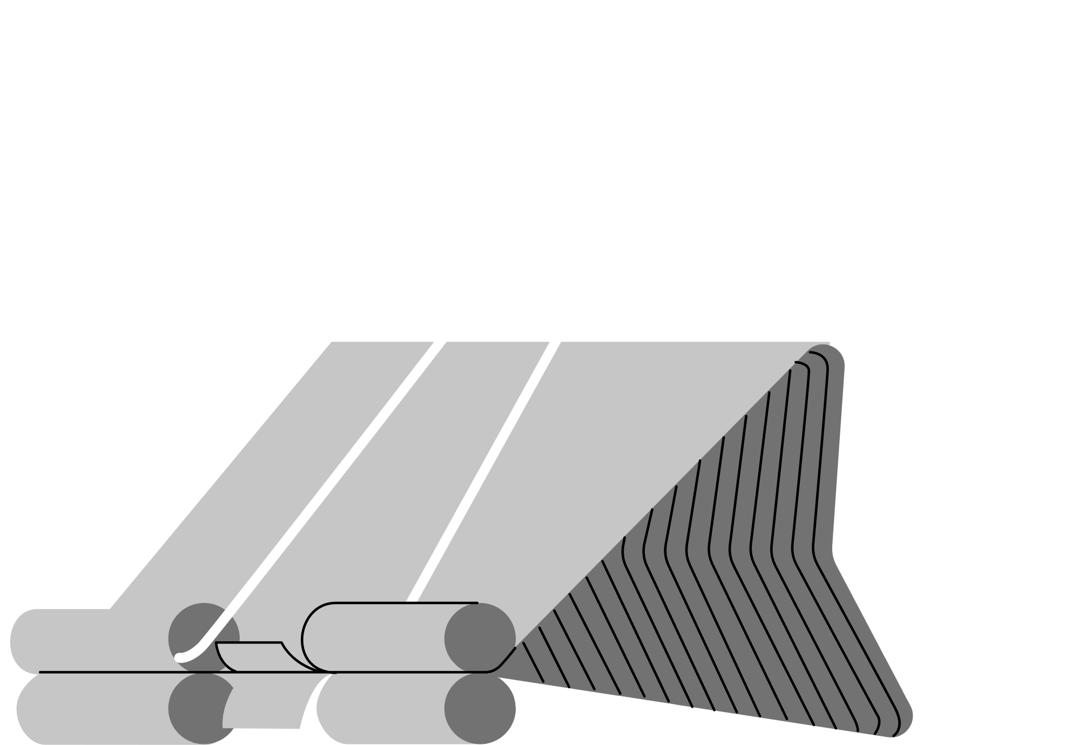

THE RECOMMENDATION
Once you have gathered all the required information and the supporting documents, you will conclude your Absconder Report by making a recommendation to the sending state.
Request Discharge | Request Revocation
Notes:
Once you have gathered all the required information and the supporting documents, you will conclude your Absconder Report by making a recommendation to the sending state to either request discharge or request revocation.
Key factors to consider when making a recommendation include whether a parent or legal guardian remains in the sending state and the juvenile’s overall compliance with terms and conditions prior to absconding.
If the juvenile absconded from supervision after several months of non-compliance (which have been reported to the sending state via a Violation Report), it may be critical to recommend that the sending state’s court request revocation.
A request for revocation using a return and formal sanctions can help steer the juvenile back down the path to success.

Slide 16
The Receiving State may close the
case based on one of two circumstances:
1 | Notification that a warrant has been issued by the sending state
2 | The juvenile has been on absconder status for ten (10) business days
Notes:
Once the Absconder Report has been submitted, the receiving state may close the supervision case based on one of two circumstances:
-notification that a warrant has been issued by the sending state OR
-the juvenile has been on absconder status for ten business days.
It is important to note that when the receiving state closes an ICJ Case, the receiving state must complete the Form X and provide the reason for closure. In this case it would be: juvenile has absconded.

Slide 17
1 | Return the juvenile to the Sending State
2 | Submit a request to resume supervision in the receiving state
Found or apprehended the juvenile?
Notes:
Upon finding or apprehending the juvenile, the sending state shall make a determination whether to:
Return the juvenile to the sending state or
Submit a request to resume supervision in the receiving state.

Slide 18
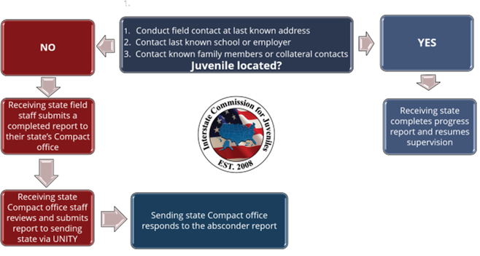
Notes:
The flowchart shown here depicts the complete rule in action.

Slide 19

TIME FOR QUESTIONS!
Please unmute yourselves or type your questions into the chat box.

Slide 20
LET'S PUT IT IN ACTION!
UNITY
DEMONSTRATION

Slide 21
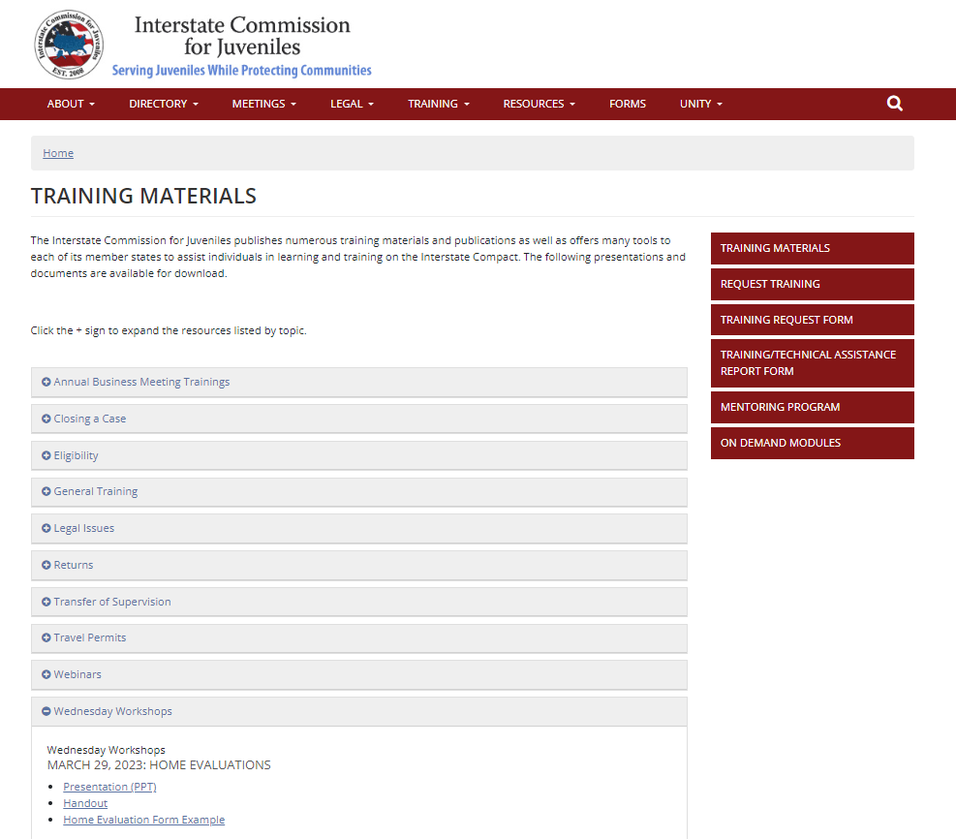


TRAINING MATERIALS
Notes:
If you would like to download a copy of this presentation, handout, and sample form for in-state trainings, visit the "Training Materials" page on the Commission's website.

Slide 22

UPCOMING WEDNESDAY WORKSHOPS
Every Wednesday in March: Rule Amendment Training
May 1, 2024: Best Practice on Home Evaluation Considerations for Unconventional Families Training
Notes:
Save the Date! Our Wednesday Workshop training sessions will be presented (typically) on the last Wednesday of each month from 1:00 - 2:00 pm EST.
Next month will be a little bit different, as we will have training sessions every Wednesday to prepare for the upcoming Rule Amendments.
Session A will be offered on the first and second Wednesday of March and Session B will be offered on the third and fourth Wednesday of March.
Registration is required.
On May 1st, members of the Racial Diversity, Equity, and Inclusion Committee will present a training on their recently published best practice on home evaluations for unconventional families.
Please visit the calendar on the Commission's website to access additional information and the Zoom links to the sessions.
That's all for today! Thank you for joining us and we look forward to seeing you next month!

